Slide 1
GASTROINTESTINAL BLEEDING
Do Van Y16H-45

Slide 2
1. What is GI Bleeding?
2. Signs and symptoms
3. Cause of GI Bleeding
4. Treatment

Slide 3
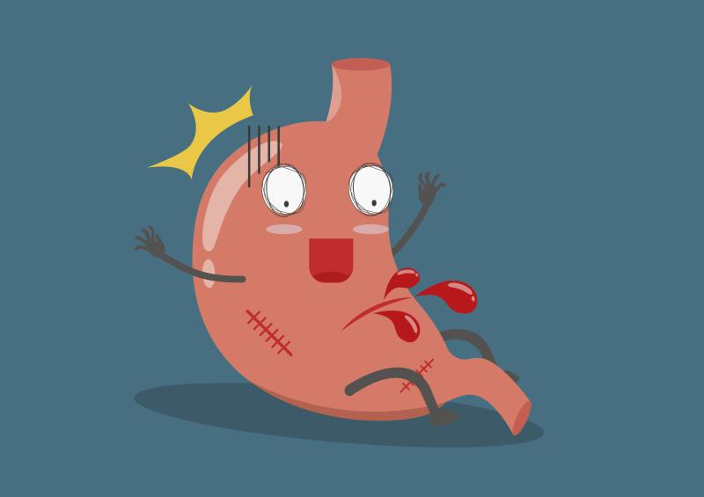
What is GI Bleeding?
Gastrointestinal Bleeding ( GI Bleeding) is when bleeding occurs in any parts of the gastrointestinal tract.
It itself is not a disease but a symptom of many conditions

Slide 4
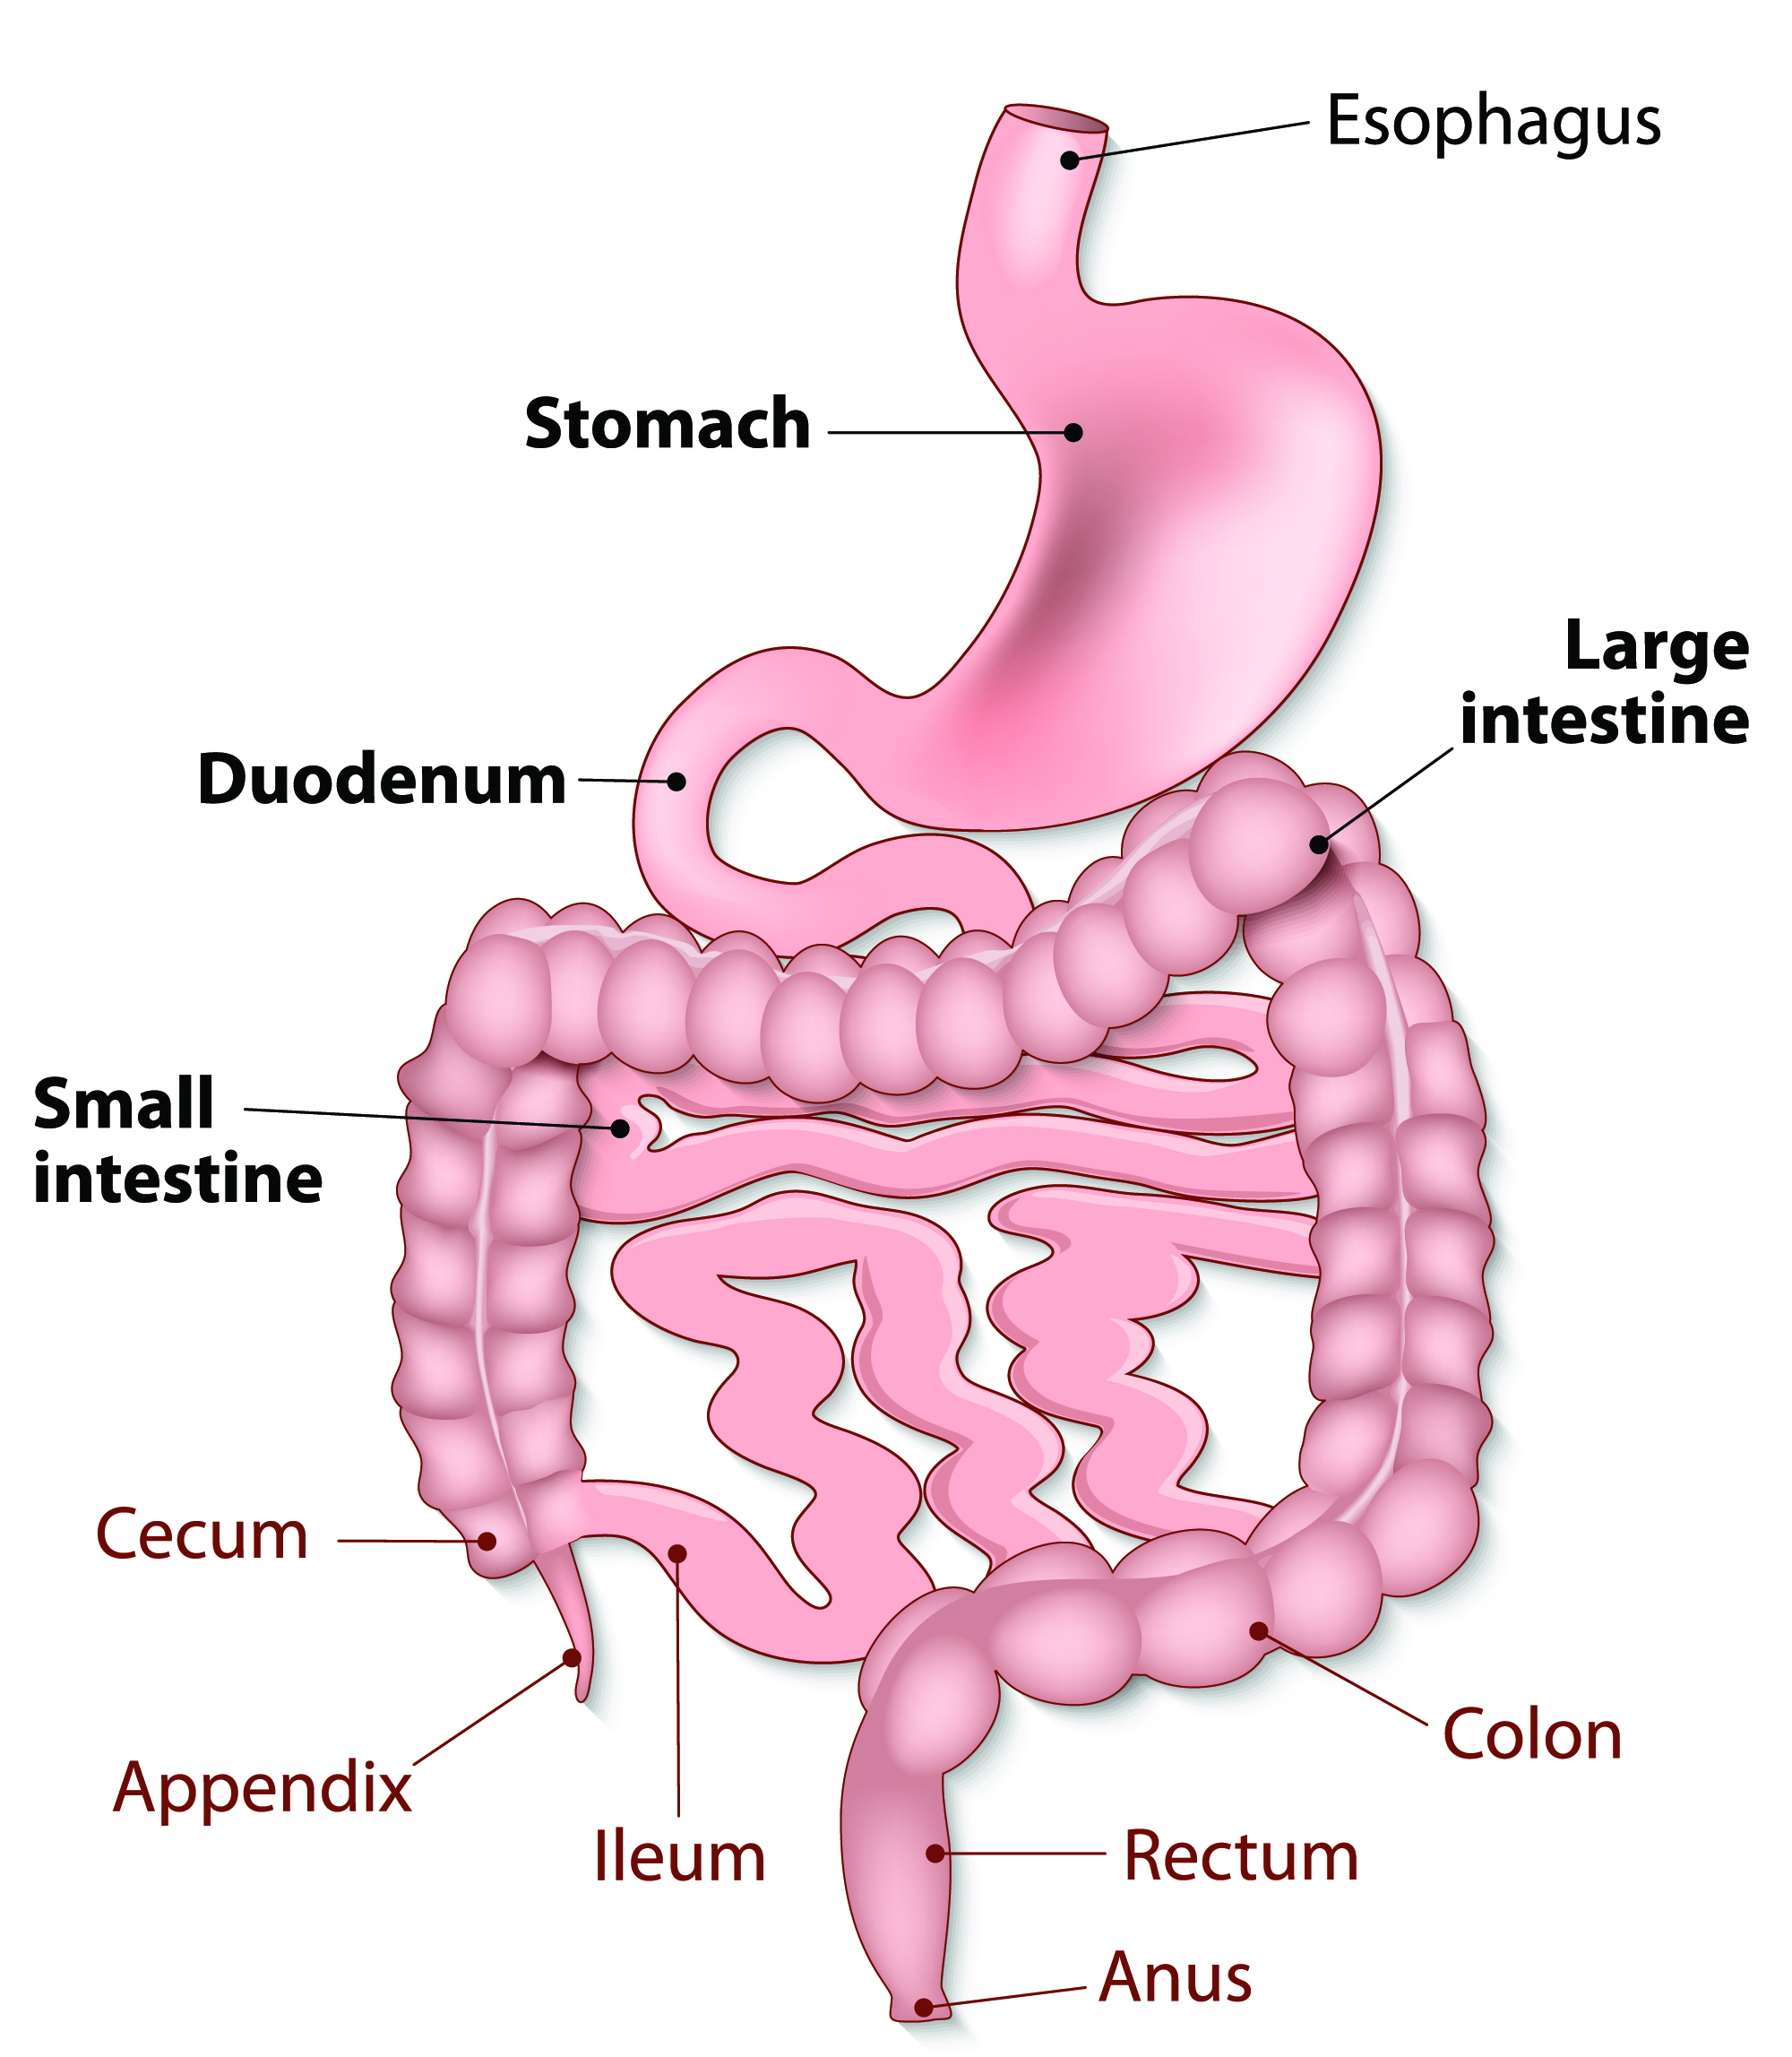
Bleeding can come from any of these areas.
The amount of bleeding can be so small that only a lab test can find it

Slide 5
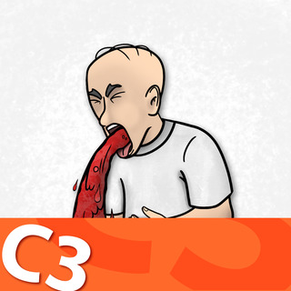
SIGNS AND SYMPTOMS
Signs of bleeding in the digestive tract depend on where it is and how much bleeding there is
Upper GI Bleeding:
Bright red blood in vomitting
Vomit that looks like “ coffee grounds”
Black or tarry stool
Dark blood mixed with stool
Lower GI Bleeding:
Black or tarry stool
Dark blood mixed with stool
Stool mixed or coated with bright red blood

Slide 6
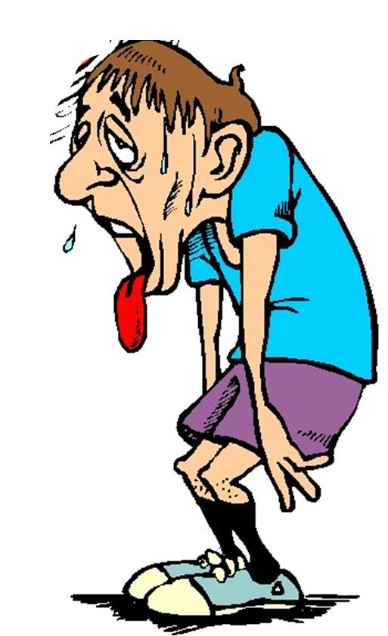
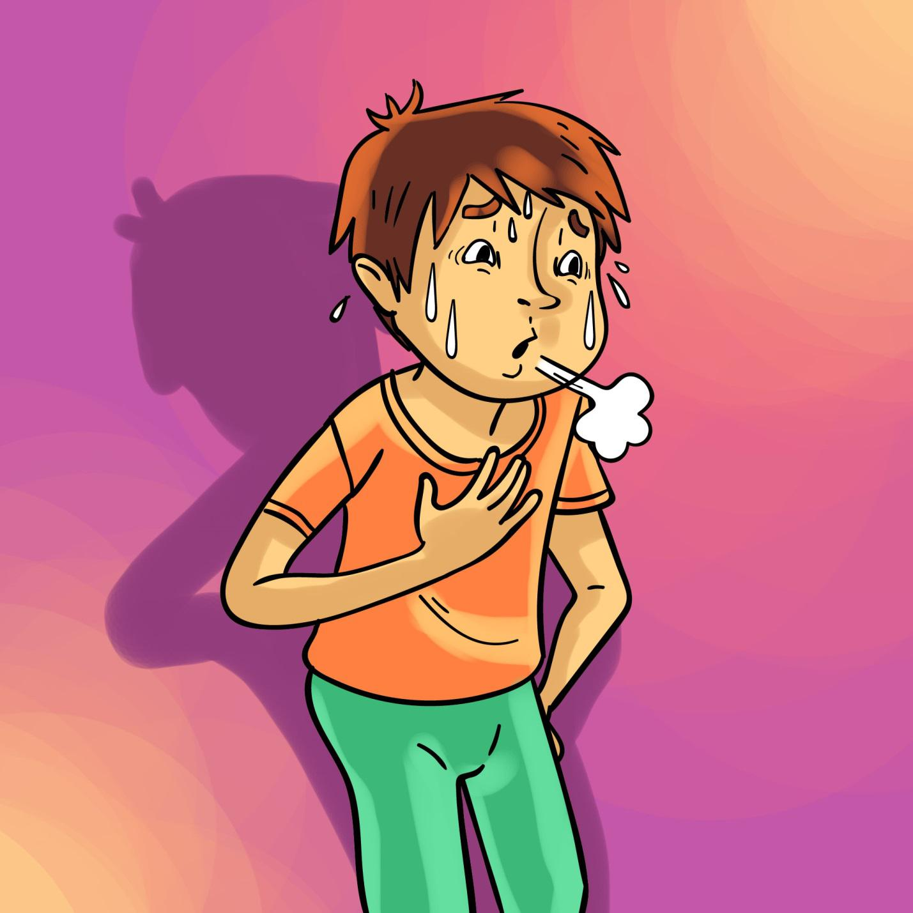
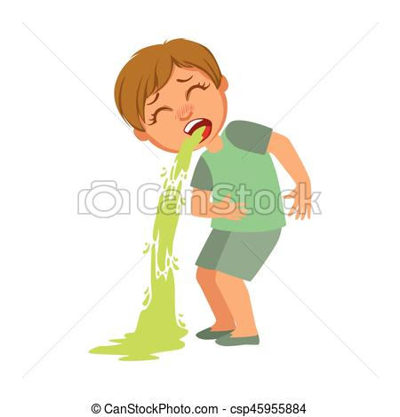
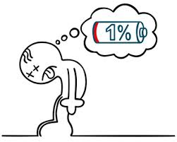
The person may also experience some symptoms such as:
Fatigue
Weakness
Pale skin
Shortness of breath

Slide 7
GI BLEEDING’S CAUSE
The causes and risk factors for gastrointestinal (GI) bleeding are classified into upper or lower, depending on their location in the GI tract.
Upper GI Bleeding:
Peptic Ulcers
Gastritis ( bleeding in the stomach)
esophageal varices
inflammation of the GI lining from ingested materials
Lower GI Bleeding:
Diverticulitis
gastrointestinal cancers
Inflammatory bowel disease
Infectious diarrhea
polyps

Slide 8
MEDICATION AND TREATMENT
There is no home care for heavy gastrointestinal bleeding
a diet high in fiber, fluids to keep stools soft may be helpful, and stool softeners
The doctor may need to resuscitate the patient with IV fluids and possibly a blood transfusion
In some cases, the patient may need surgery
A person should go to a hospital's emergency department if they have heavy gastrointestinal bleeding

Slide 9

preventation
-Avoid foods and triggers, such as alcohol and smoking that increase gastric secretions
-Eat a high-fiber diet to increase the bulk of the stool, which helps prevent diverticulosis and hemorrhoids

Slide 10
THANKS!
Any questions?
You can find me at
0935956963
dovanbmt11@gmail.com

